Slide 1
Simplifying User Experiences at USA Gov
Simplifying user experiences for complex content at USAGov
Notes:
Notes from Digital.gov:
“Please address the bullet points below. Many of them can be resolved by running the accessibility checker in powerpoint. When you're done, there should be no Errors or Warnings. Please make your updates to the deck attached in this email and send it back to us”.
Fix Object Descriptions / add Alternative Text on slides 7,10,12,13,16,17
Regarding the quote on slide 5, this may need to be removed but the Digital.gov team is confirming
Add slide title for slide 17
Fix Reading Order on slides 4,7,9,10,12,13,14,17
Regarding the video clip on slide 13: Video clips cannot be used, and private companies cannot be mentioned. This part of the presentation needs to be reworked. Please see Guidelines for Digital.gov event presenters for more information
Regarding the image on slide 16: If it's not an agency-owned or Microsoft PPT stock image, be sure you have permission from your agency's Office of General Counsel to use the image. Make sure the source for each image is found in the slide notes.
The contact information on slide 19 needs to be updated
“Regarding the more complex diagrams in the slides, please be prepared to describe all images on the screen with proper audio descriptors. More information also in Guidelines for Digital.gov event presenters.”

Slide 2
Introductions: Joanne and Dita
Joanne McGovern
Mercedita Andrew
UX Researcher
USAGov
she/her
Contractor, UX Researcher
USAGov
she/her
Notes:
Introductions and descriptions: Joanne and Mercedita

Slide 3
Defining the problem
1
Defining the problem
Notes:
Dita’s slide:
What exactly is the problem? Let’s go ahead and define it!

Slide 4
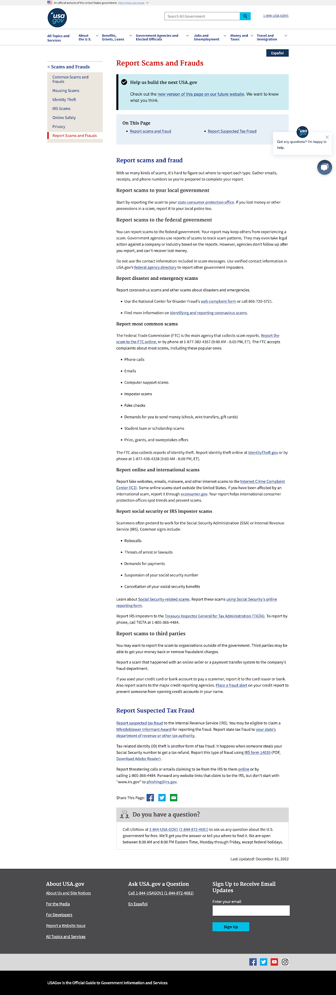
Defining the problem: description
Defining the problem
The page content is complex
Plus the page is long and pretty dense
And the user could be in an emotional state
Notes:
Dita’s slide:
Everyone wants a simple product, but few people talk about the process that it takes to make a product simple. The irony of simplicity is that you must go through a complex process, to get that simple product at the end. You must understand all the complexity around it from users, the feature requirements, to the context of use. All these things can add complexity.
(Read the first 2 points and explain the following:
If the user is in an emotional state, their minds doesn’t process the same as their are in a calm state)

Slide 5
Simplicity
Simplicity is how well you deal with the challenges of complexity.
Notes:
Dita’s slide:
There are three things that makes a product simple:
An underlying and understandable structure, which is the logic that you understand when to use a product or service.
Should be optimized for most people, most of the time, so we look at all the possible situations and find a solution that will satisfy most of our users. The system takes on the burden of the complexity, so it doesn’t reflect that complexity back at you and solves a problem for you.

Slide 6
Content design
2
Content design
Notes:
Joanne’s slide

Slide 7




USA Gov content design process
Cross functional teams
Deep dive into data to learn about audience and intents
Develop prototypes
Review and approve
before content is written
Notes:
Joanne’s slide

Slide 8
Human-centered design
Human-Centered Design is a creative problem-solving process that begins with understanding human needs and ends with innovative solutions to address those needs.
Notes:
Joanne’s slide

Slide 9
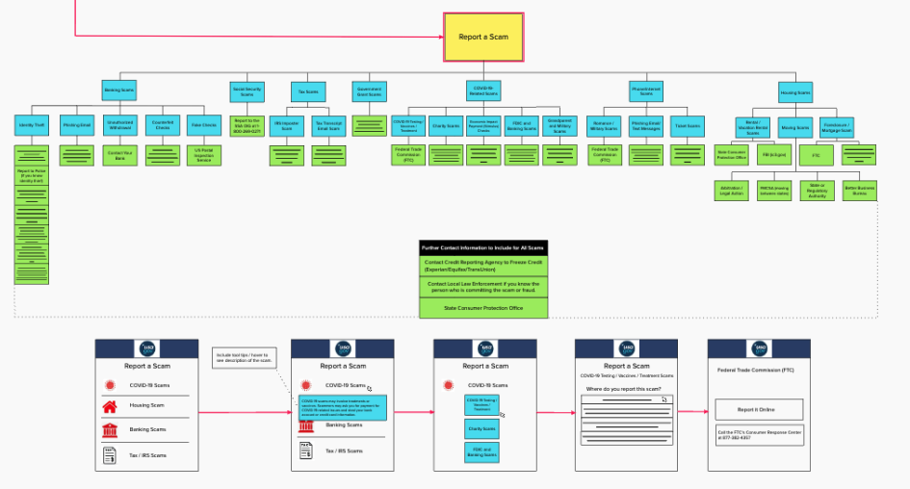
Imagining a solution
Notes:
Joanne’s slide

Slide 10
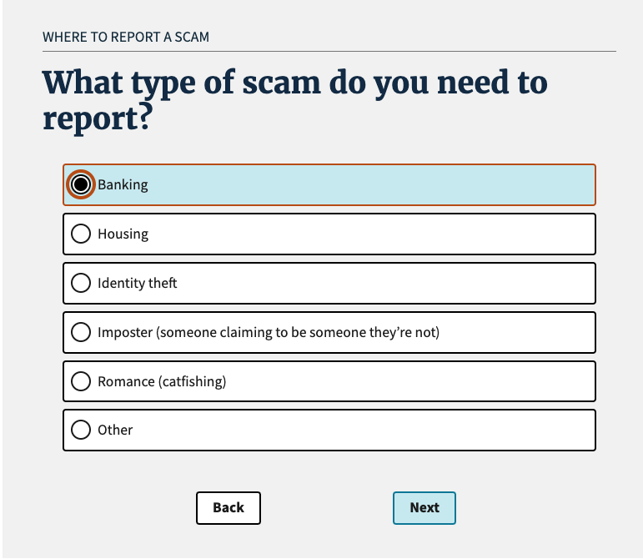
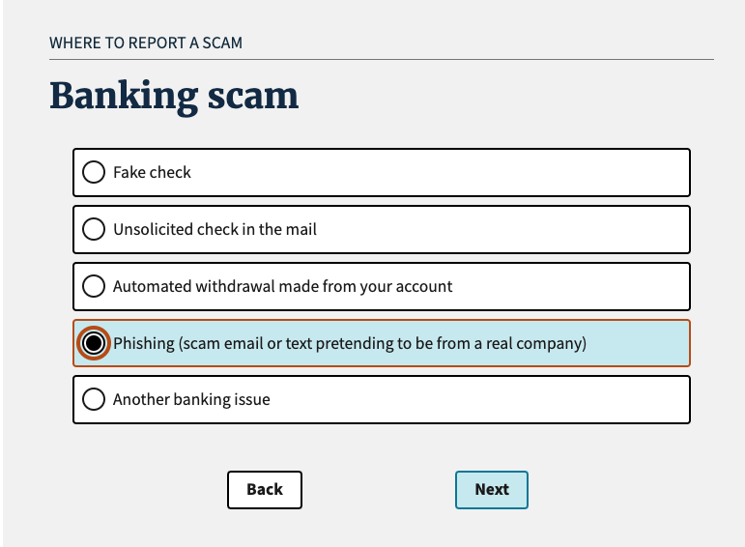
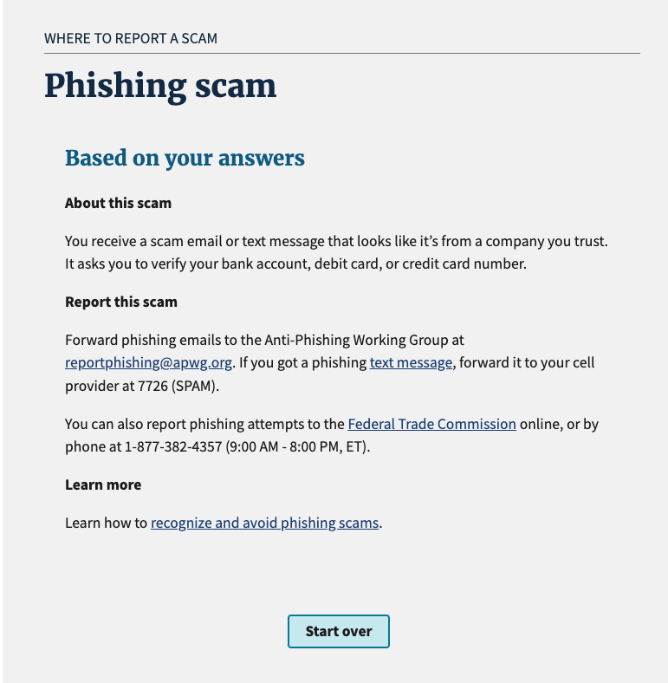
Building the tool
Notes:
Joanne’s slide:
Coding, design, accessibility, content, ux, analytics

Slide 11
Our usability testing
3
Usability testing
Notes:
Dita’s slide:
Give a context of what problem you were trying to solve, or a super brief objective of your usability testing study

Slide 12



About this usability test
Tested our Scams Wizard prototype
Remote and moderated
30 minute conversational interviews
5 English & 1 Spanish mobile users
4 English & 4 Spanish desktop users
Notes:
Dita’s slide:
I would like to describe how we do usability testing at USAGov…
(A brief objective of this usability testing study and a quick intro why “Scams” and how that fits into our work)

Slide 13
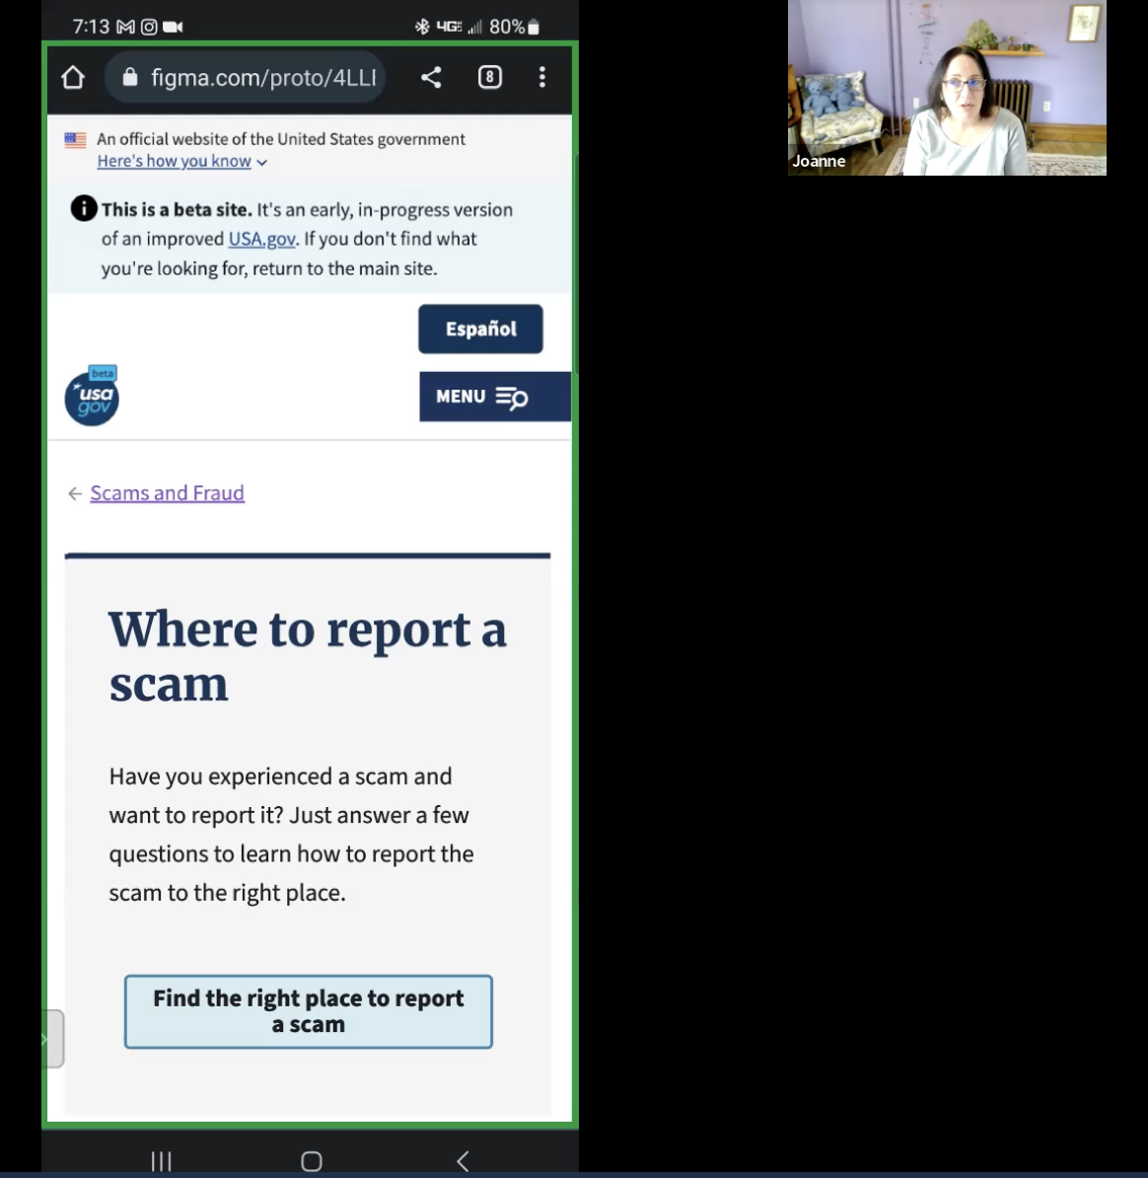
Testing our mobile prototype with a user
Moderator: “Do you prefer the shorter screen, to the point or do you feel like that little bit of extra information would be helpful?”
User: “To a person in this situation I think less is more. If you're having to look through too much information, you start getting a little confused and you even start panicking. The shorter version is right to the point and let’s me know what needs to be handled”
Notes:
Dita’s slide:
The user had the opportunity to navigate both web pages, mothership and new USAGov.
The Scams Wizard on current USAGov website draws participants attention, due to the simplified experience.

Slide 14
What we learned from this usability test 1
1
Participants highlighted the emotional stage and stressful times when experiencing a scam.
Notes:
Dita’s slide:
Remarks from usability study (read 1st point)

Slide 15
What we learned from this usability test 2
1
2
Participants highlighted the emotional stage and stressful times when experiencing a scam.
By removing unnecessary wording and creating a cleaner wizard, the participants felt calmer.
Notes:
Dita’s slide:
Remarks from usability study (read 2nd point)

Slide 16
What we learned from this usability test 3
1
2
3
Participants highlighted the emotional stage and stressful times when experiencing a scam.
By removing unnecessary wording and creating a cleaner wizard, the participants felt calmer.
Most participants prefer the scams wizard because is intuitive, clear, simple, and useful.
Notes:
Dita’s slide:
Remarks from usability study (read 3rd point)
The wizard is now live at our current USAGov website. Share on chat

Slide 17
Voice user interface
4
Voice user interface
Notes:
Reference from Digital.gov notes: this was originally page 15
Joanne’s slide

Slide 18

Adapting for voice interface
Adapting for voice interface
Notes:
Reference from Digital.gov notes: this was originally page 16
The rights to use this image are owned by GSA through a subscription to Getty Images.
Joanne’s slide

Slide 19
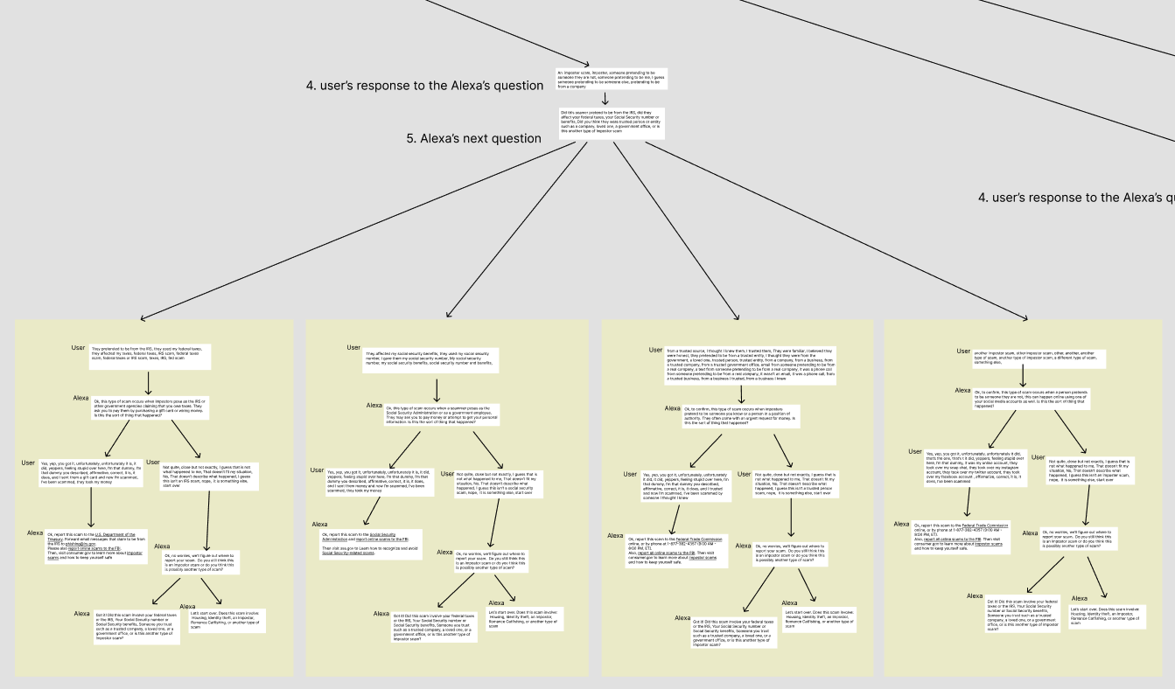
Conversation design
Notes:
Reference from Digital.gov notes: this was originally page 17
Joanne’s slide

Slide 20
Conclusion
5
Conclusion
Notes:
Reference from Digital.gov notes: this was originally page 18
Joanne’s slide:
This is an example of some of the things we are doing at USAGov.
We are looking to create more tools like this to this to simplify our complex content.

Slide 21
Thanks!
Thanks!
Contact joanne.mcgovern@gsa.gov mercedita.andrewnazario@gsa.gov
Follow @USAGov
blog.usa.gov

